Slide 1
Impatto delle terapie farmacologiche (Glp1, Gip, dual agonisti) su organi e tessuti. Imaging del rimodellamento corporeo e della risposta metabolica ai farmaci anti-obesità
Rossi Antonio
I.R.C.C.S. Ospedale Galeazzi - Sant'Ambrogio
Dept of Biomedical and Clinical Sciences, Università di Milano

Slide 2
Antonio Rossi, in the last two years, has received speaking and/or consulting fees from:
Roche Diabetes Care
Abbott Diabetes Care
Ypsomed AG

Slide 3
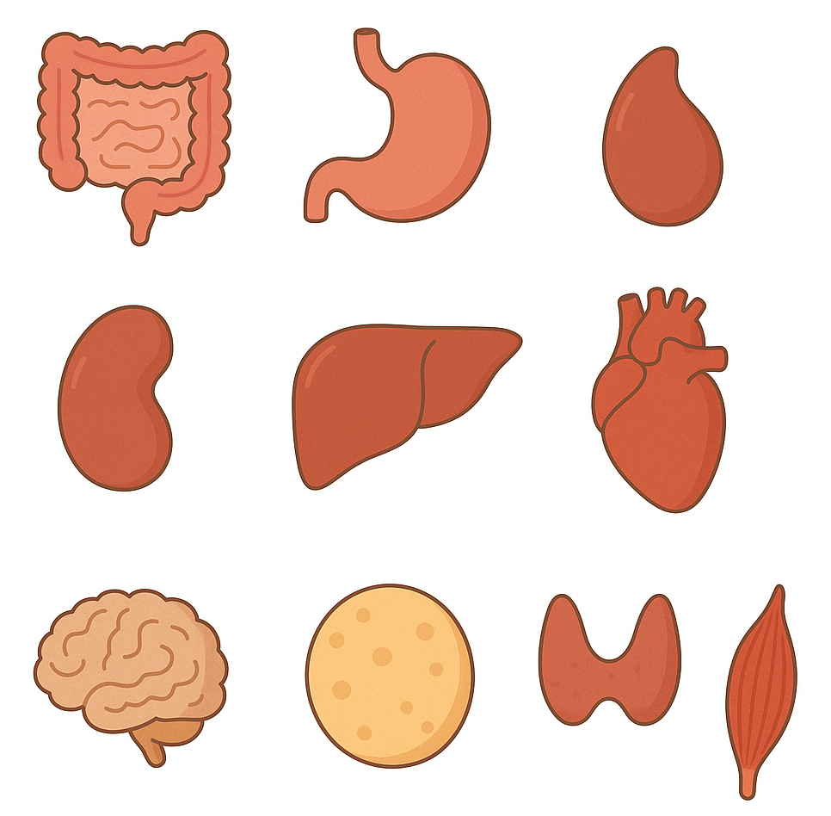
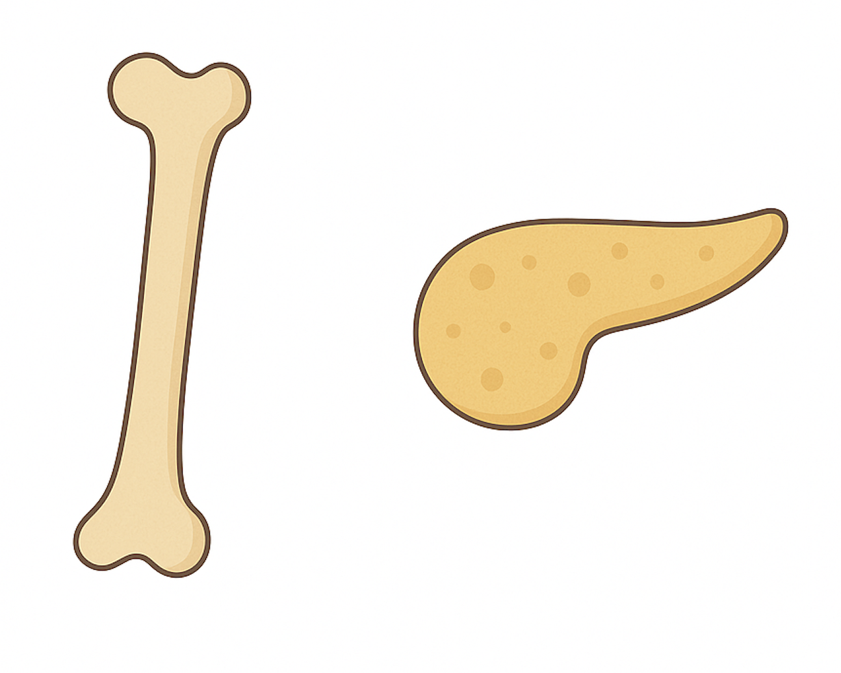
Agenda
GLP1RA
GIP
Glucagone
Rimodellamento corporeo e risposta metabolica
Notes:
– apparato cardiovascolare
– fegato e rene
– apparato muscolo scheletrico

Slide 4
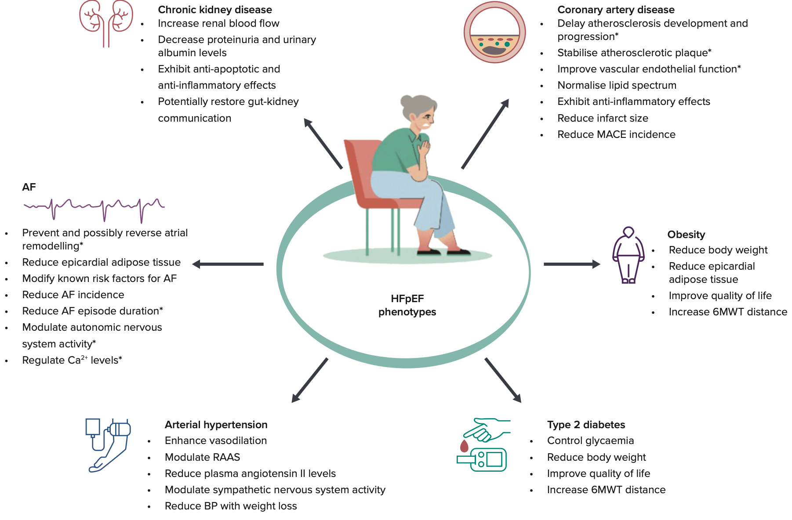
Bykova A, Card Fail Rev 2024

Slide 5
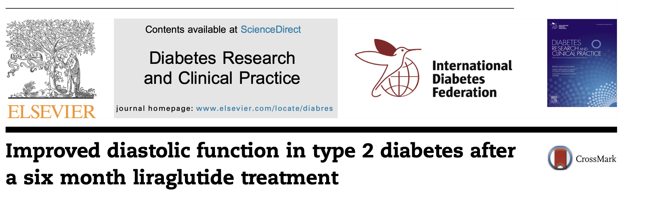
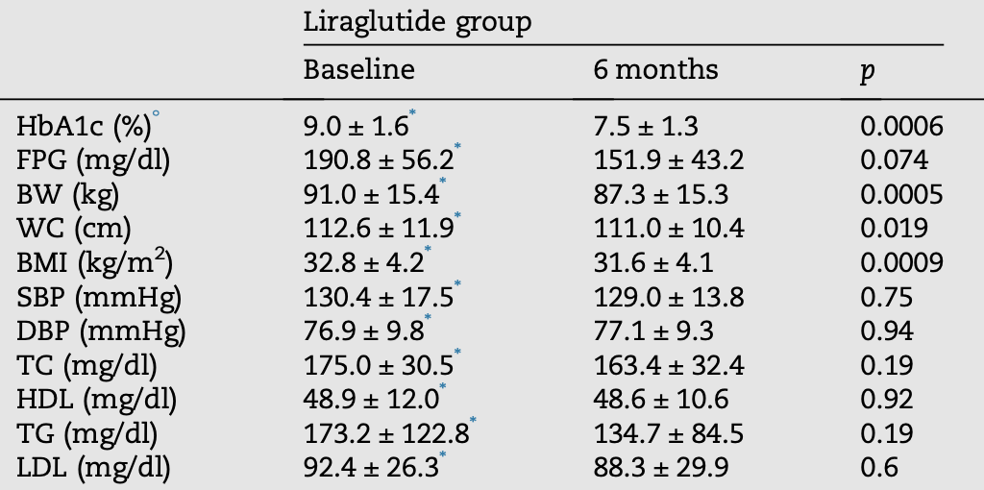
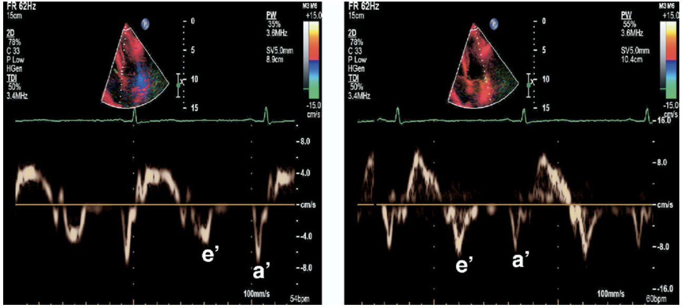
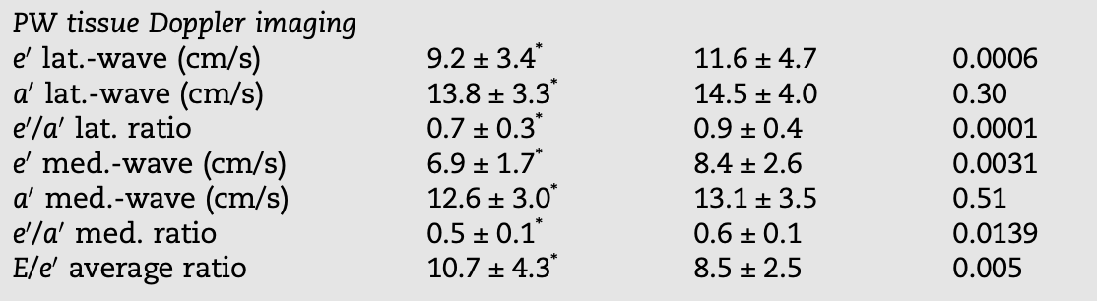
Saponaro F, DRCP 2016

Slide 6
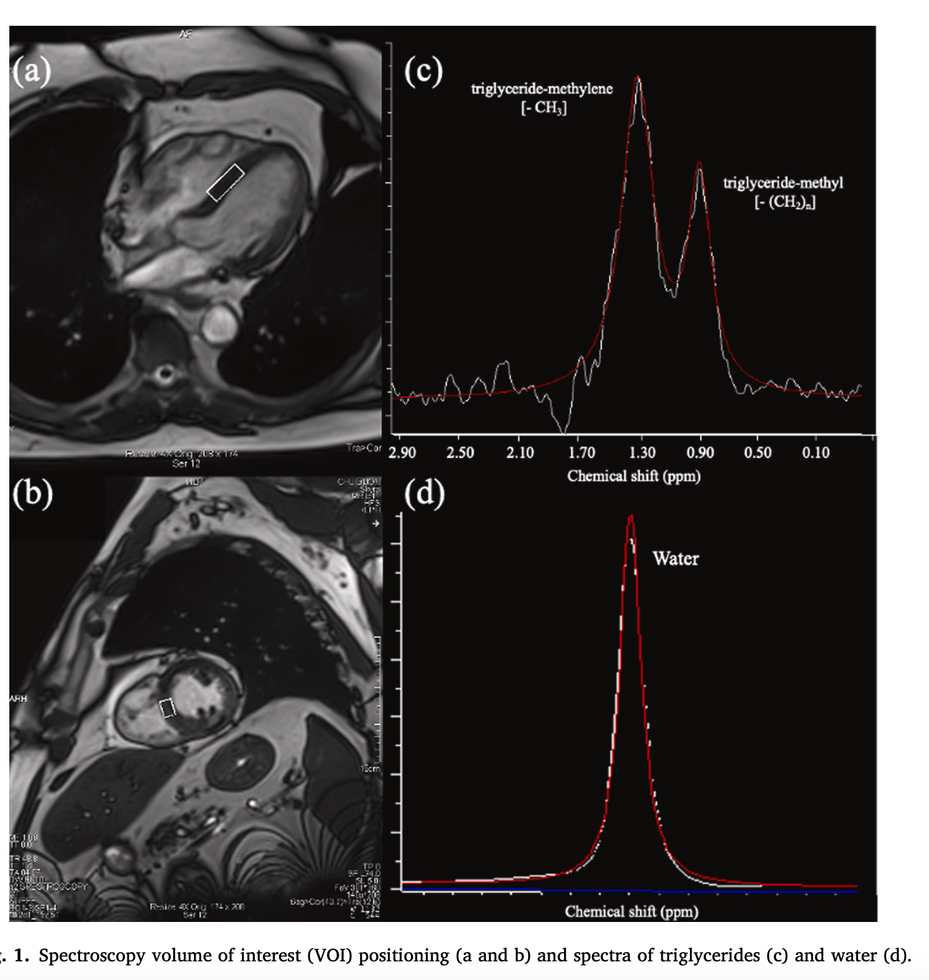
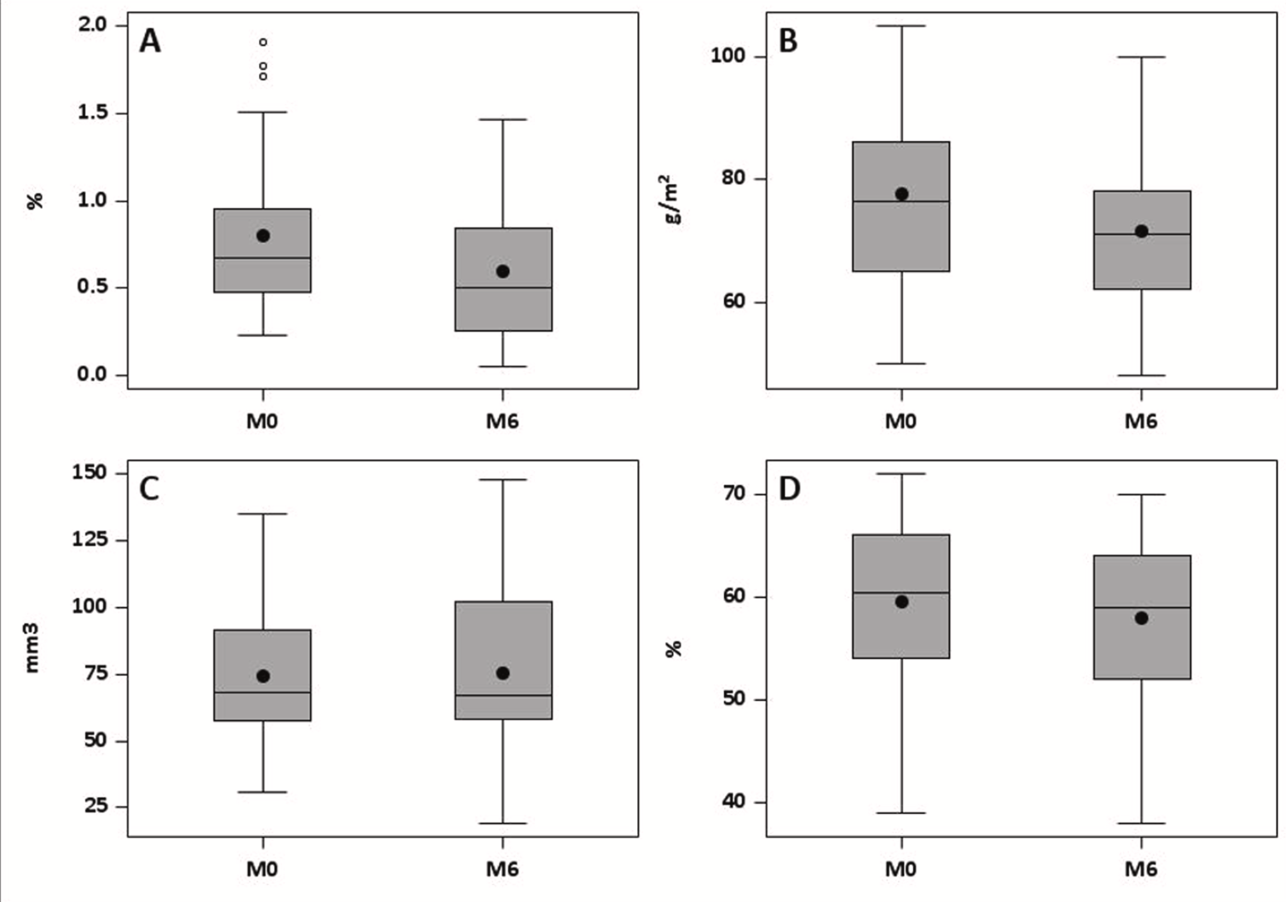
Myocardial steatosis with GLP1 receptor agonists: LICAS study
Intramyocardial triglyceride level (A), left ventricular mass (B), epicardial fat volume (C) and left ventricular ejection fraction (D) at baseline and at six months.
Houbachi L, DRCP 225
Notes:
Evolution of myocardial steatosis in high cardiovascular risk T2DM patients treated by GLP1 receptor agonists: LICAS study
A SIN Spectroscopy volume of interest (VOI) positioning (a and b) and spectra of triglycerides (c) and water (d).

Slide 7
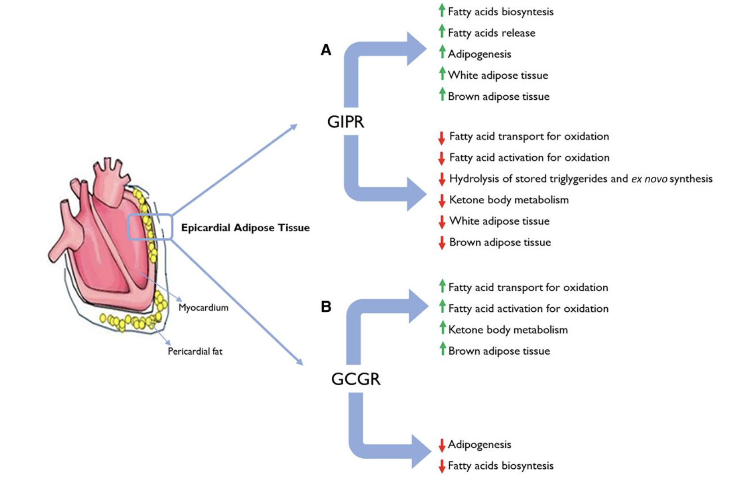
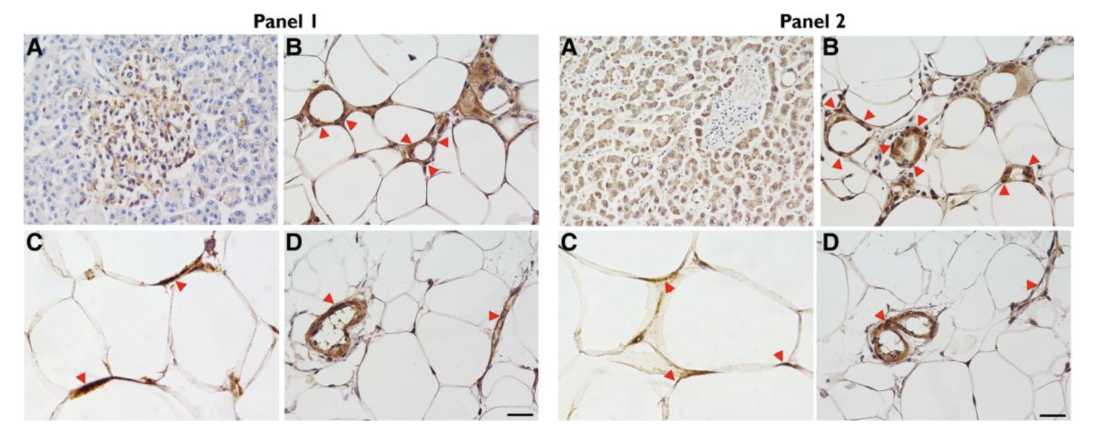
Epicardial adipose tissue expresses glucose-dependent insulinotropic polypeptide, glucagon, and glucagon-like peptide-1 receptors as potential targets of pleiotropic therapies
Malavazos AE, Eur J Prev Cardiol 2023

Slide 8
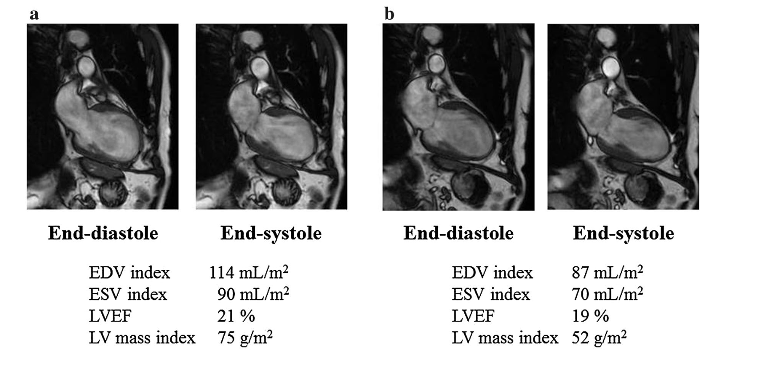
Liraglutide on left ventricular remodeling
End-diastolic volume index, end-systolic volume index, left ventricular mass
index decreased
Nozue T, Heart Vessels 2016
Notes:
Left
ventricular ejection fraction did not change, whereas the end-diastolic
volume index, end-systolic volume index, and left ventricular mass
index decreased by the 6-month follow-up

Slide 9
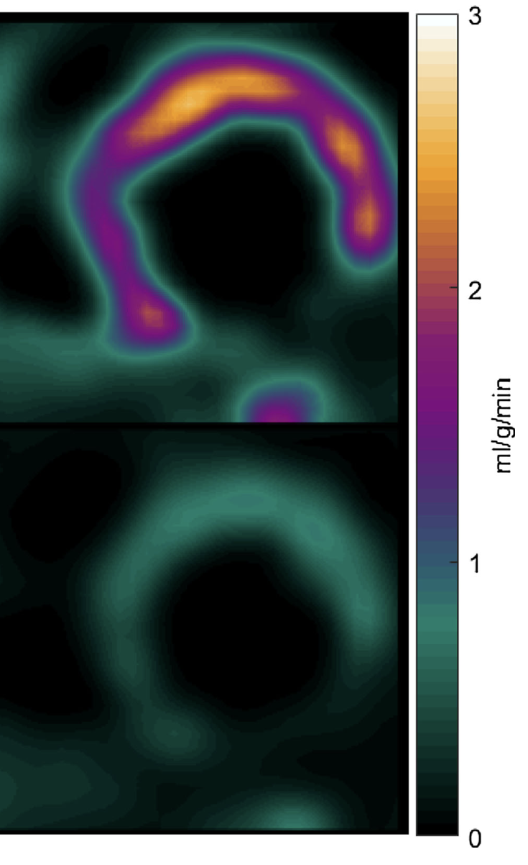
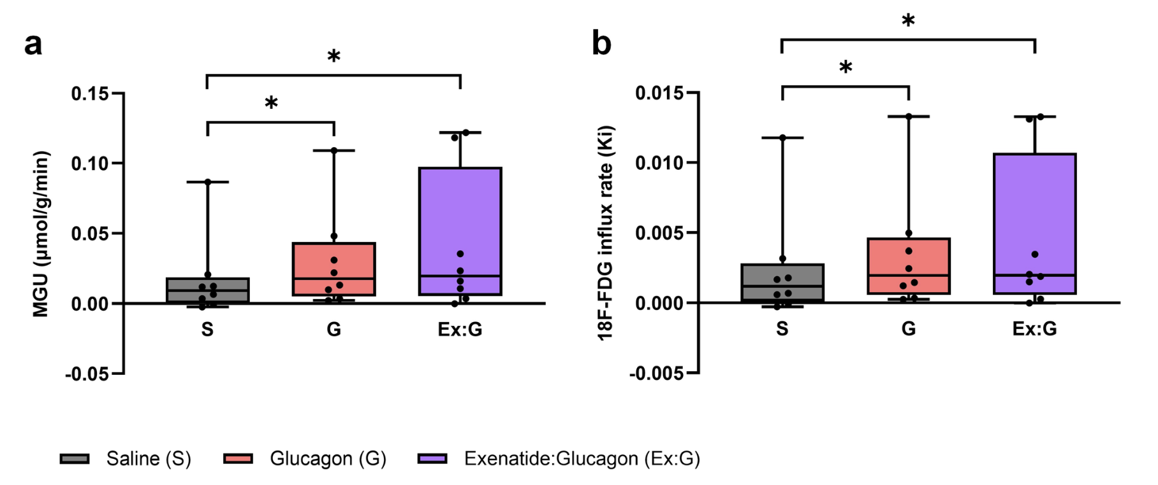
GLP1-RA on myocardial glucose uptake and blood flow
Liraglutide
Exenatide and glucagon co-infusion increases the 18F-FDG influx rate (Ki) and MGU in T2D overweight
Nielsen R, J Nucl Cardiol 2019
Goodman J, Scient Rep 2025
Notes:
NIELSEN Stable chronic heart failure patients
Despite a reduction in HbA1c and lowering of glucose levels during an OGTT, liraglutide did not affect global or segmental MGU or MFR in HF patients without
T2D. These findings may explain the absence of beneficial effects in the LIVE and FIGHT12 studies, but they also demonstrate that the increase in cardiac events in these studies does not involve decreases in MGU or MFR.
Hence, the present findings do not support any glucometabolic effect on the failing myocardium by liraglutide treatment, but demonstrates its glucose-lowering properties in chronic HF patients even in the absence of T2D.
GOODMAN In this human study of overweight adults with T2D, glucagon and exenatide:glucagon co-infusion significantly increased the 18F-FDG influx rate (Ki) and MGU. Exenatide: glucagon significantly increased the LV global peak diastolic circumferential strain rate and significantly decreased the LV global peak diastolic radial strain rate.
Exenatide:glucagon numerically increased the LV longitudinal contraction as shown by a reduction in LV global longitudinal strain. Glucagon and exenatide: glucagon co-infusion was well tolerated with an acceptable safety profile.
Myocardial glucose uptake is the process by which the heart muscle takes in glucose to use as fuel for energy, which is regulated by glucose transporters (GLUT1 and GLUT4). This uptake is stimulated by factors like insulin, exercise, and ischemia, and it allows the heart to switch to glucose as its primary energy source during times of high demand or stress, as explained in this JACC article. Inside the cell, glucose is metabolized through glycolysis to produce energy (ATP).
LV global peak diastolic circumferential strain rate (GCSR-d) is a measure of the heart's ability to relax and fill with blood during diastole

Slide 10
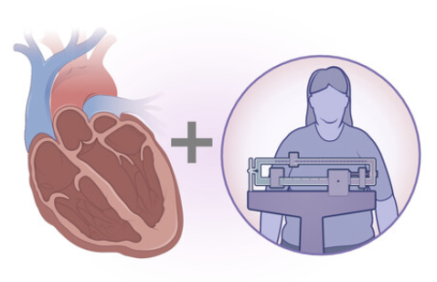

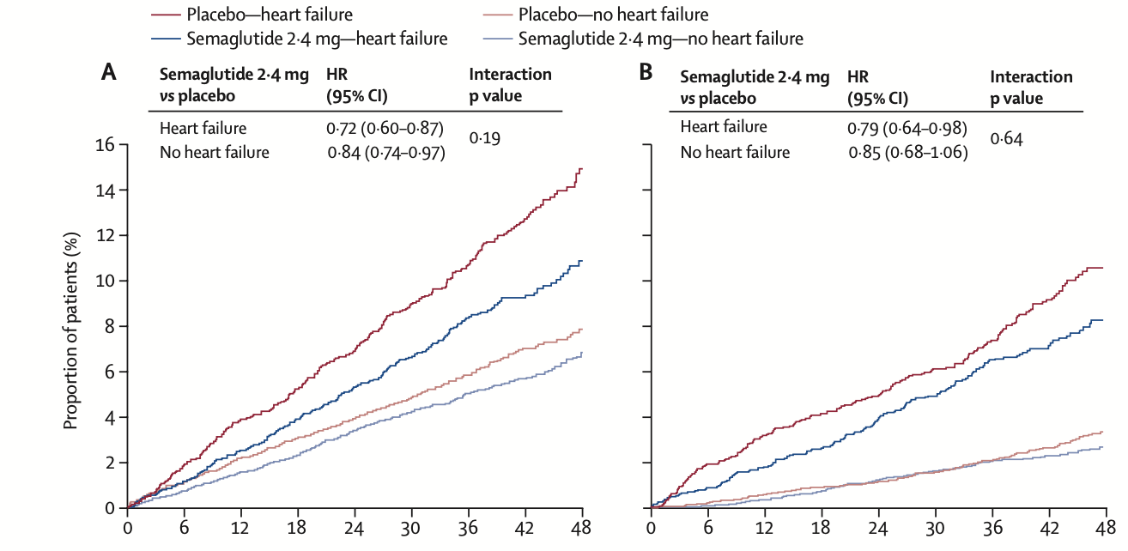
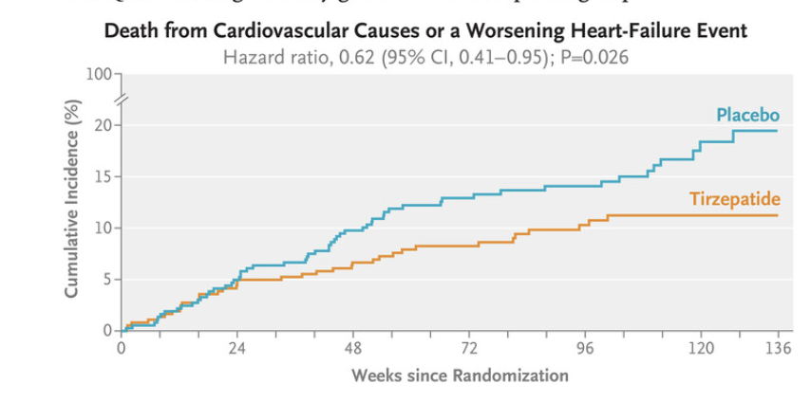
Semaglutide and Tirzepatide on HF
Reduced MACE, heart failure composite, cardiovascular death and all-cause death in patients with atherosclerotic cardiovascular disease and overweight or obesity and heart failure
Packer M, NEJM 2025
Deanfield J, Lancet 2024
Notes:
SUMMITT - Tirzepatide for Heart Failure with Preserved Ejection Fraction and Obesity
SELECT Trial - In a multicenter, double-blind, randomized, placebo-controlled, event-driven superiority trial, we enrolled patients 45 years of age or older who had preexisting cardiovascular disease and a body-mass index (the weight in kilograms divided by the square of the height in meters) of 27 or greater but no history of diabetes. Patients were randomly assigned in a 1:1 ratio to receive once-weekly subcutaneous semaglutide at a dose of 2.4 mg or placebo. The primary cardiovascular end point was a composite of death from cardiovascular causes, nonfatal myocardial infarction, or nonfatal stroke in a time-to-first-event analysis. Safety was also assessed

Slide 11
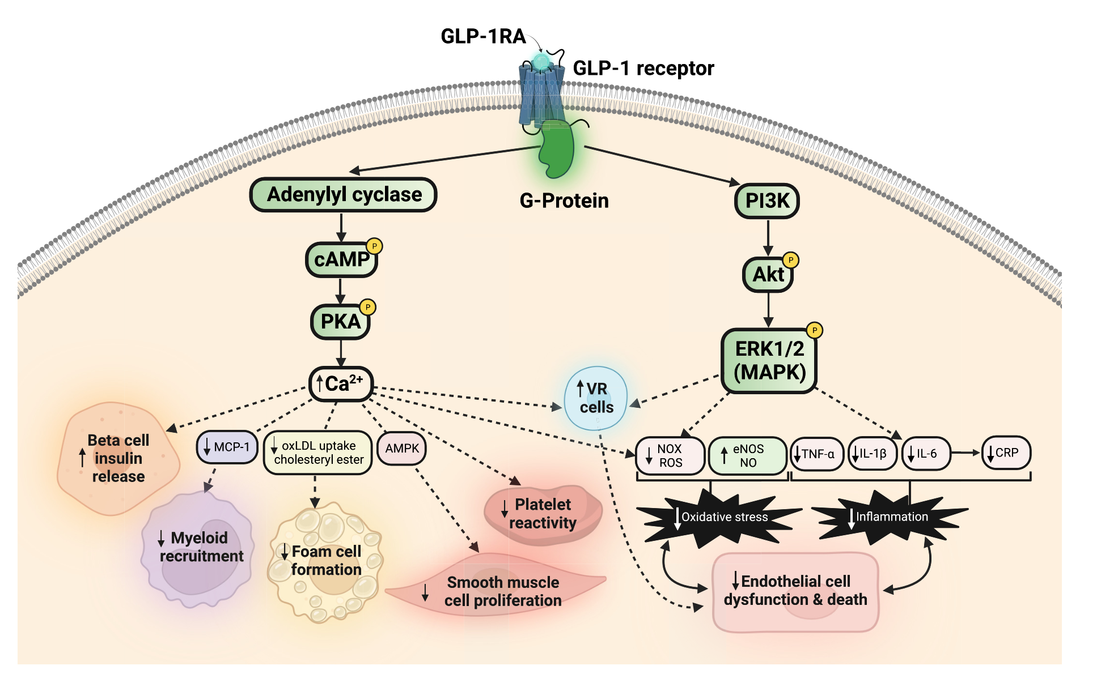
GLP-1 receptor agonists and atherosclerosis protection
The vascular endothelium takes center stage
Promotion of Angiogenesis
Suppression of Oxidative Stress and
Systemic Inflammation
Park B, Am J Physiol Heart Circ Physiol 2024

Slide 12
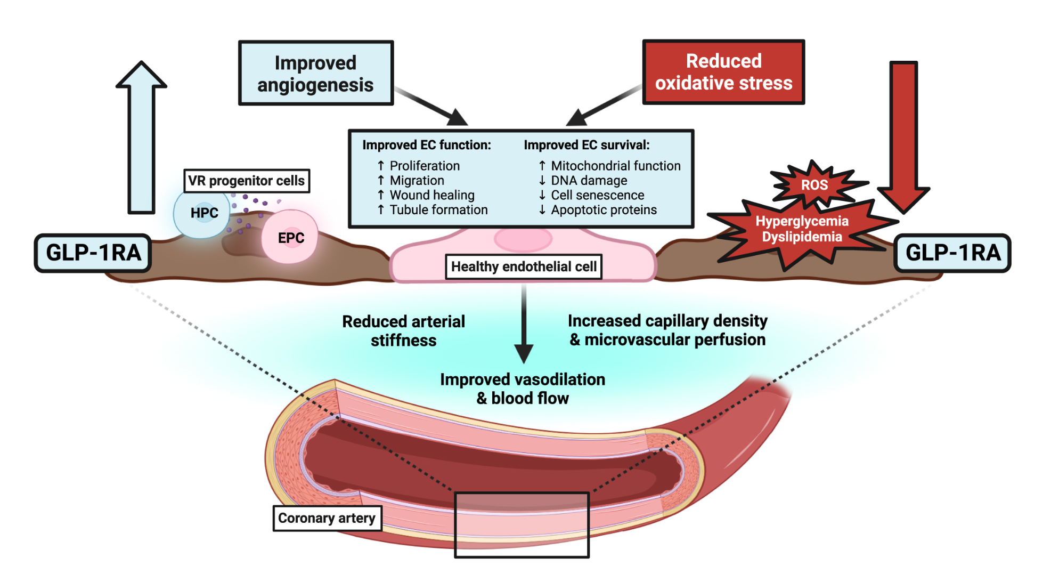
GLP-1 receptor agonists and atherosclerosis protection
The vascular endothelium takes center stage
Potential Targets of GLP-1 Receptor Agonists
Lipid core
Fibrous cap (foam cells and VSMCs)
Macrophages
Coagulation
Systemic Inflammation …
Park B, Am J Physiol Heart Circ Physiol 2024
Notes:
Modulators of endothelial health and dysfunction targeted by glucagon-like peptide-1 (GLP-1) receptor agonists (GLP-1RAs). GLP-1RAs can pre- vent endothelial dysfunction through the promotion of angiogenesis and the reduction of oxidative stress. The proangiogenic actions of GLP-1RAs can be driven by the increased content and function of vascular regenerative (VR) progenitor cells, comprising of myeloid hematopoietic progenitor cells (HPC) and endothelial precursor cells (EPC) that coordinate vessel repair through paracrine signaling. The antioxidative actions of GLP-1RAs are driven by the suppression of hyperglycemia and dyslipidemia, which are closely associated with reactive oxygen species (ROS) production. Together, improved angiogenesis and reduced oxidative stress enhance the function and survival of endothelial cells (ECs), which can drive improvements in cardiovascular function including reduced arterial stiffness, improved vasodilation and blood flow, and increased microvascular perfusion. These improvements counter- act endothelial dysfunction induced by a hyperglycemic and lipotoxic vascular environment present during diabetes or obesity. ECs, endothelial cells; HbA1c, hemoglobin A1c; LDL-C, low-density lipoprotein cholesterol; TG, triglycerides. Figure created with a licensed version of BioRender.com.
Advanced plaques thereafter consist of a lipid core and a fibrous cap composed of foam cells and VSMCs embedded within a dense extracellular matrix, contributing to progressive vessel thickening. On occasion, the fibrous cap may become destabilized by proteases released from macrophages, leading to plaque rupture and coagulation.

Slide 13
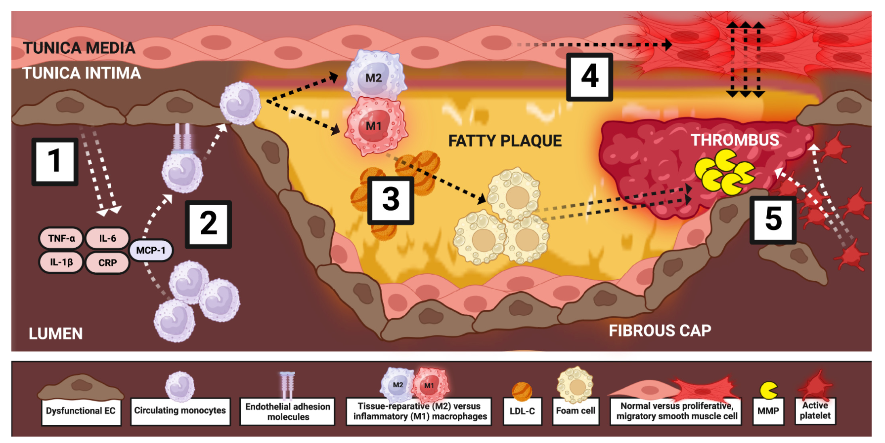
GLP-1 receptor agonists and atherosclerosis protection
Park B, Am J Physiol Heart Circ Physiol 2024
Notes:
Figure 3. The antiatherosclerotic targets of glucagon-like peptide-1 (GLP-1) receptor agonists (GLP-1RAs) during endothelial dysfunction. In the context of established endothelial dysfunction, the antiatherosclerotic targets of GLP-1RAs include the suppression of (1) inflammatory cytokine production and secretion, (2) monocyte recruitment, adhesion, and infiltration, (3) M1 proinflammatory macrophage polarization and foam cell formation, (4) intimal thicken- ing induced by the differentiation of vascular smooth muscle cells into a proliferative, migratory phenotype, and finally, (5) fatty lesion formation, plaque rupture, and thrombosis. CRP, C-reactive protein; IL-1b, interleukin-1b; IL-6, interleukin-6; LDL-C, low-density lipoprotein cholesterol; MCP-1, monocyte che- moattractant protein-1; MMP, matrix metalloproteinase; TNF-a, tumor necrosis factor-a. Figure created with a licensed version of BioRender.com.

Slide 14
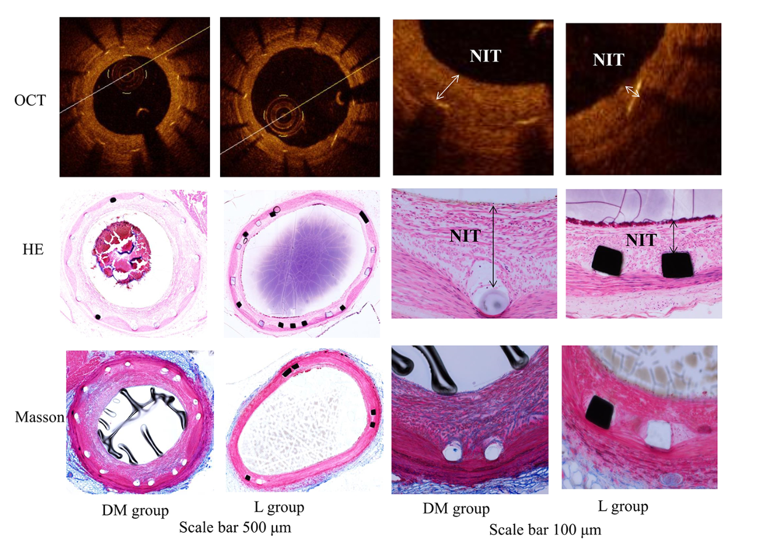
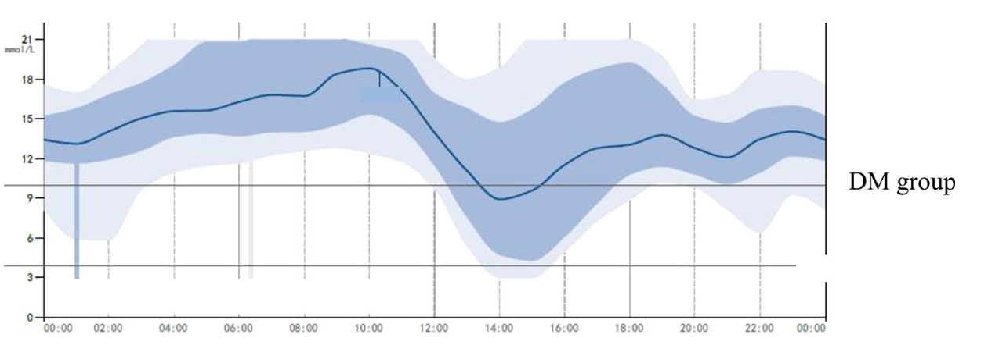
Liraglutide on intimal hyperplasia after stent implantation
GLP-1 receptor-dependent effect
regulation of glycemic variability
the NLRP3 inflammasome/IL-10 signaling
Jinggang Xia, Front Pharm 2020
Notes:
Objective: This study aimed to explore whether treatment with the glucagon-like peptide- 1 (GLP-1) analog liraglutide reduces intimal hyperplasia after coronary stent implantation
via regulation of glycemic variability, the NLRP3 in ammasome, and IL-10 in diabetic swine.
At 22 weeks, the lumen area (LA), neointimal thickness (NIT), neointimal area (NIA),
and percent area stenosis (%AS) were analyzed by optical coherence tomography.
Plasma tumor necrosis factor-a, interleukin-6, and interleukin-10 were assayed by
ELISA. The intima protein expression levels of NLRP3, interleukin-1b, interleukin-18 and
interleukin-10 were examined using Western blot analysis. Histology was used to evaluate
the healing response. In an in vitro study, THP-1 cells were divided into control, high
glucose (HG), HG + liraglutide, and HG + liraglutide + Exe(9–39) (a GLP-1 receptor
inhibitor) groups.
L'inflammasoma NLRP3 è un complesso proteico che svolge un ruolo chiave nel sistema immunitario innato, rilevando stress e danni cellulari per scatenare una risposta infiammatoria.

Slide 15
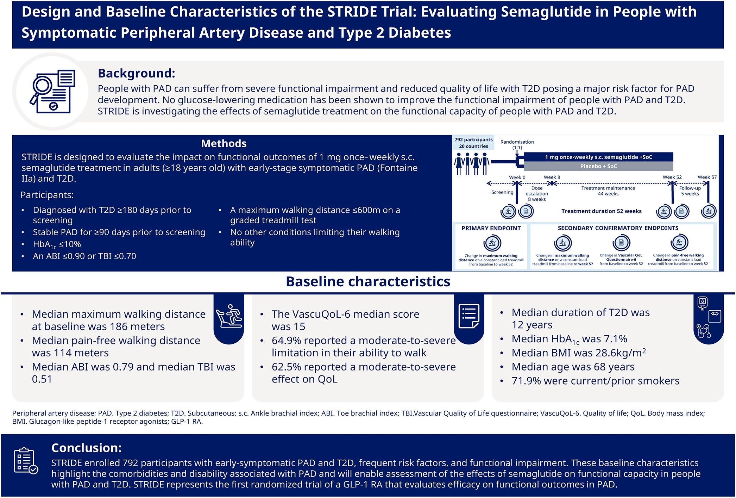
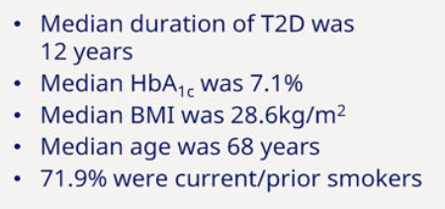
Evaluating semaglutide in people with symptomatic peripheral artery disease and type 2 diabetes
Symptomatic PAD and T2D, frequent risk factors and comorbidities, and functional impairment
STRIDE trial
Bonaca MP, Eur Heart J Cardiovasc Pharmacother 2025

Slide 16
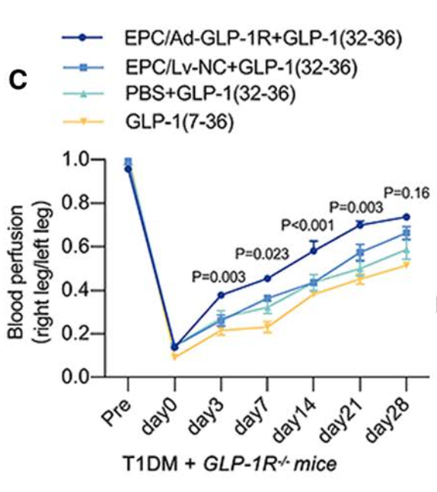
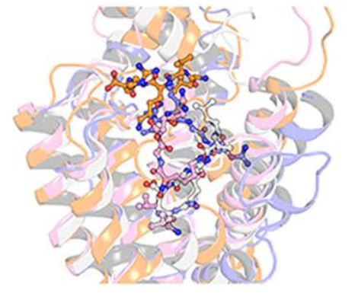
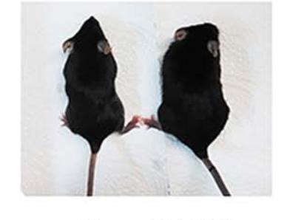
Novel Angiogenesis Role of GLP-1
GLP-1(32–36) Promotes Blood Perfusion and Angiogenesis Post-HLI in T1DM Mice Independent of Insulinotropic Actions
Both GLP-1 (glucagon-like peptide 1; 32–36) and GLP-1R (GLP-1 receptor) are required in improving angiogenesis via the eNOS (endothelial NO synthase)/cGMP/PKG (protein kinase G) pathway
Zhang Y, Arterioscler Thromb Vasc Biol 2024

Slide 17
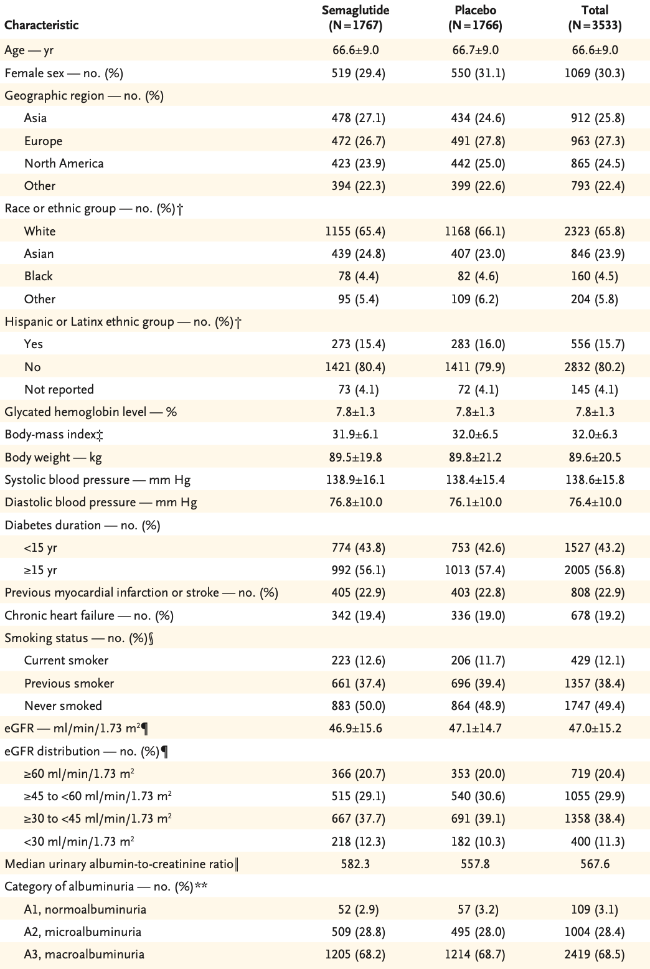
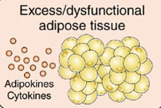
Effects of Semaglutide on Chronic Kidney Disease
FLOW Trial
STAGE 4 CKM
Obesity and CVD
Hypertrigliceridemia and CVD
Hypertension and CVD
Diabetes and CVD
CKD and CVD
Perkovic, NEJM 2024; AHA scientific statement, Circulation. 2023
Notes:
OUTCOME PRIMARIO: Evento renale maggiore, definito come il composito di insufficienza renale terminale (inizio di dialisi a lungo termine, trapianto di rene o riduzione dell’eGFR a <15 ml/min/1,73 m² per almeno 28 giorni), riduzione sostenuta (per ≥28 giorni) dell’eGFR di almeno il 50% rispetto al basale e morte per cause renali o cardiovascolari.

Slide 18
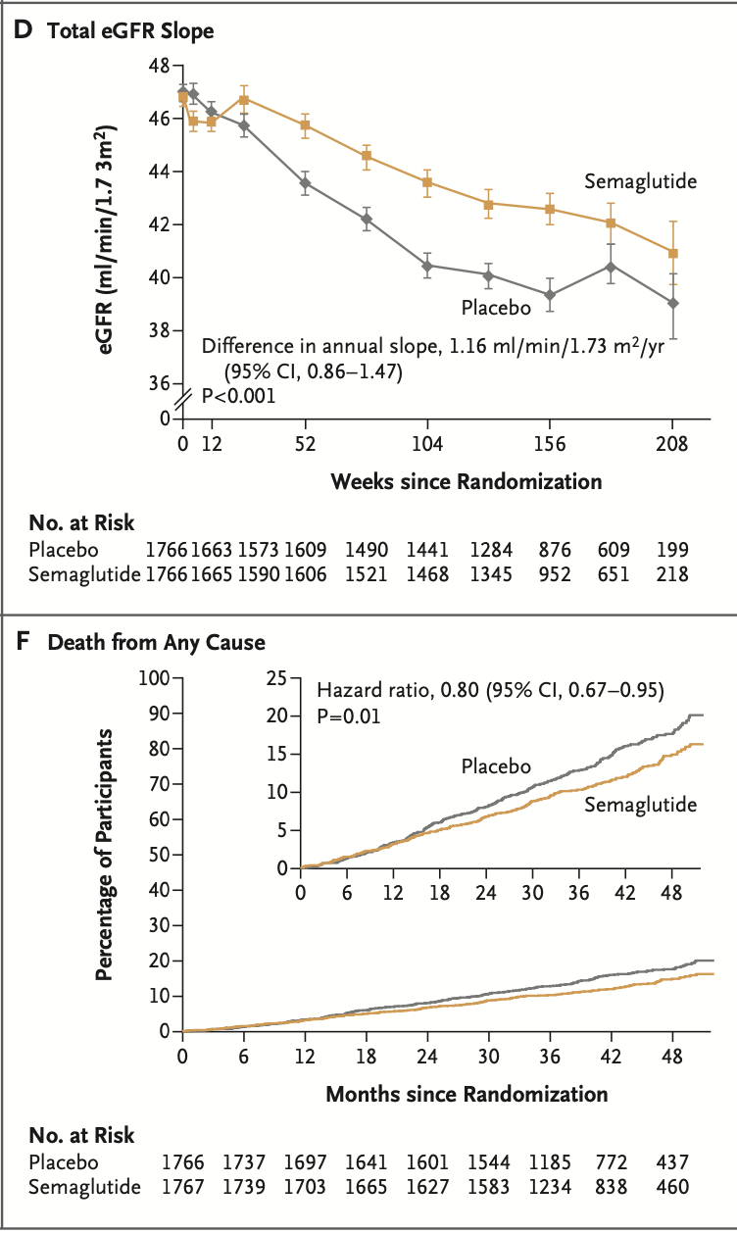
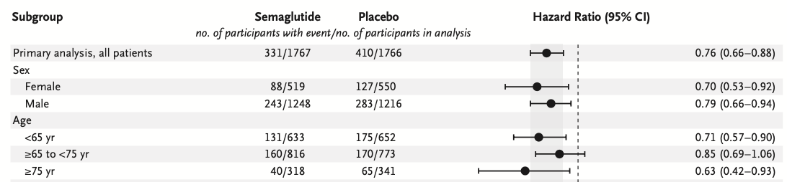
Effects of Semaglutide on Chronic Kidney Disease
FLOW Trial
Subgroup Analysis of the Primary Outcome
Perkovic, NEJM 2024
Notes:
- 5.5 Kg

Slide 19
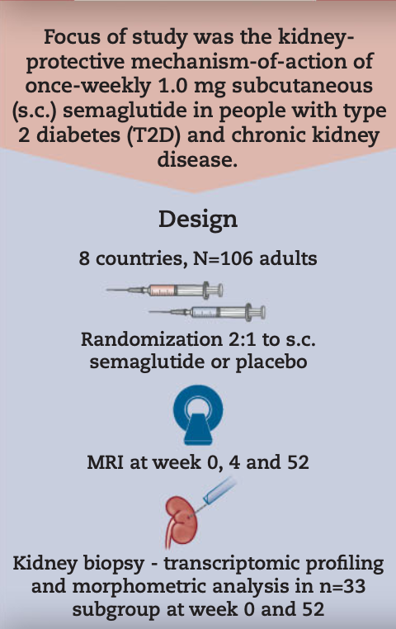
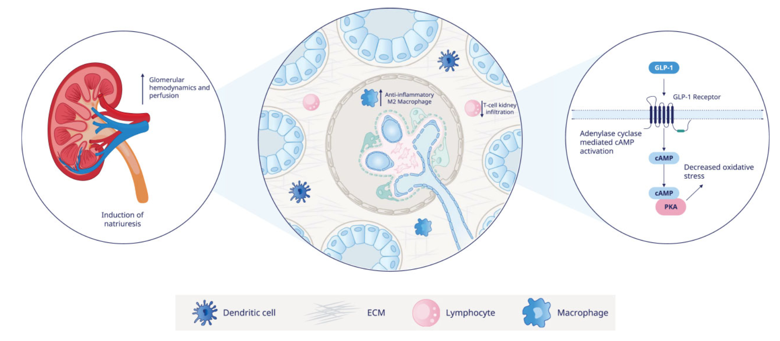
REMODEL- mechanism-of-action trial with semaglutide
Baseline
eGFR 51.1 mL/min per 1.73 m2
UACR 187 (60.5, 546) mg/g
Cherney DZI, Nephrol Dial Transplant,2025
Notes:
MRI

Slide 20
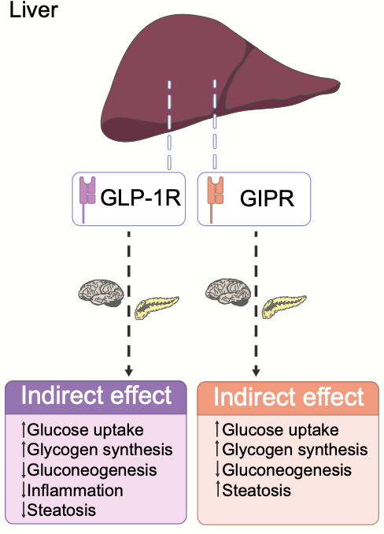
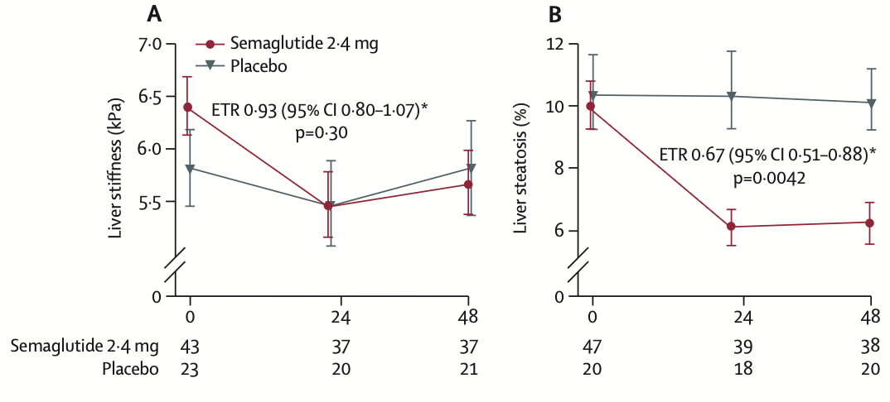
Treatment of non‑alcoholic fatty liver disease
Change in imaging parameters baseline to week 48; Semaglutide 2.4 mg once weekly in patients with non-alcoholic steatohepatitis-related cirrhosis
Andreasen CR, Diabetologia 2023
Loomba R, Lancet Gastroenterol Hepatol 2023
Notes:
In the liver, GIP and GLP-1 have indirect effects that may be generated bym changes in plasma insulin and glucagon concentrations (depicted by the image of the pancreas) and neural regulation signals (depicted by the image of the brain).

Slide 21
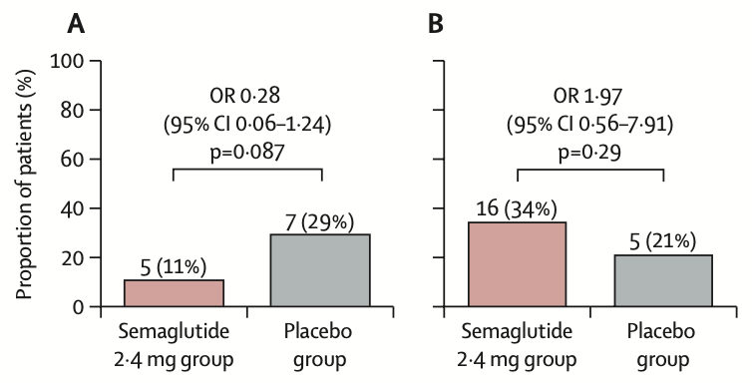
Improvement in liver fibrosis and no worsening of NASH (A) and resolution of NASH (B) at 48 weeks
Change in imaging parameters baseline to week 48; Semaglutide 2·4 mg once weekly in patients with
non-alcoholic steatohepatitis-related cirrhosis
Loomba R, Lancet Gastroenterol Hepatol 2023

Slide 22
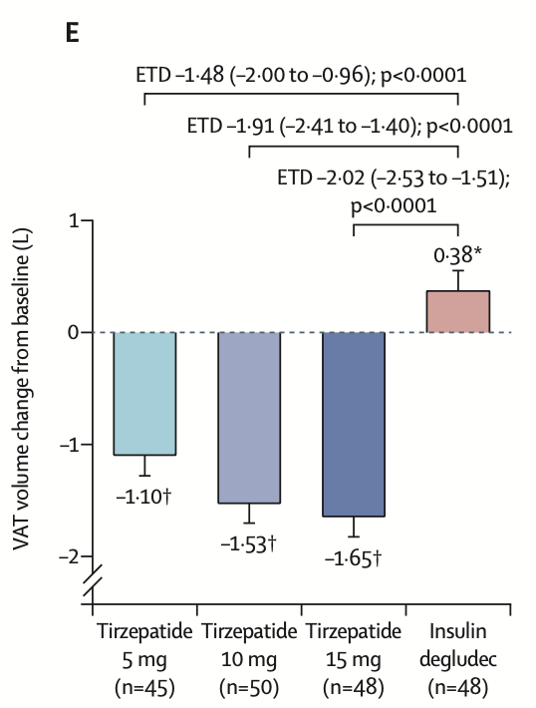
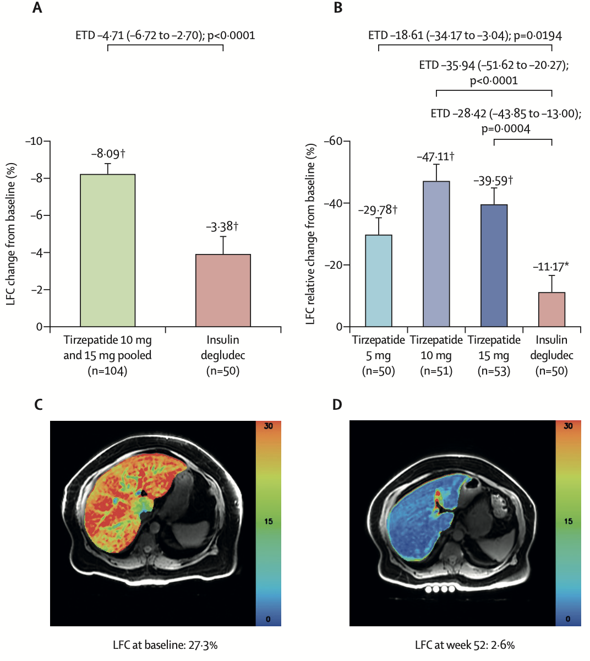
SURPASS-3 MRI
Gastaldelli A, Lancet Diab End 2022
Notes:
Aim of this substudy was to characterise the changes in liver fat content (LFC), volume of visceral adipose tissue (VAT), and abdominal subcutaneous adipose tissue (ASAT) in response to tirzepatide or insulin degludec in a subpopulation of the SURPASS-3 study.
Immagine: paziente allocato a tirzepatide 5 mg

Slide 23
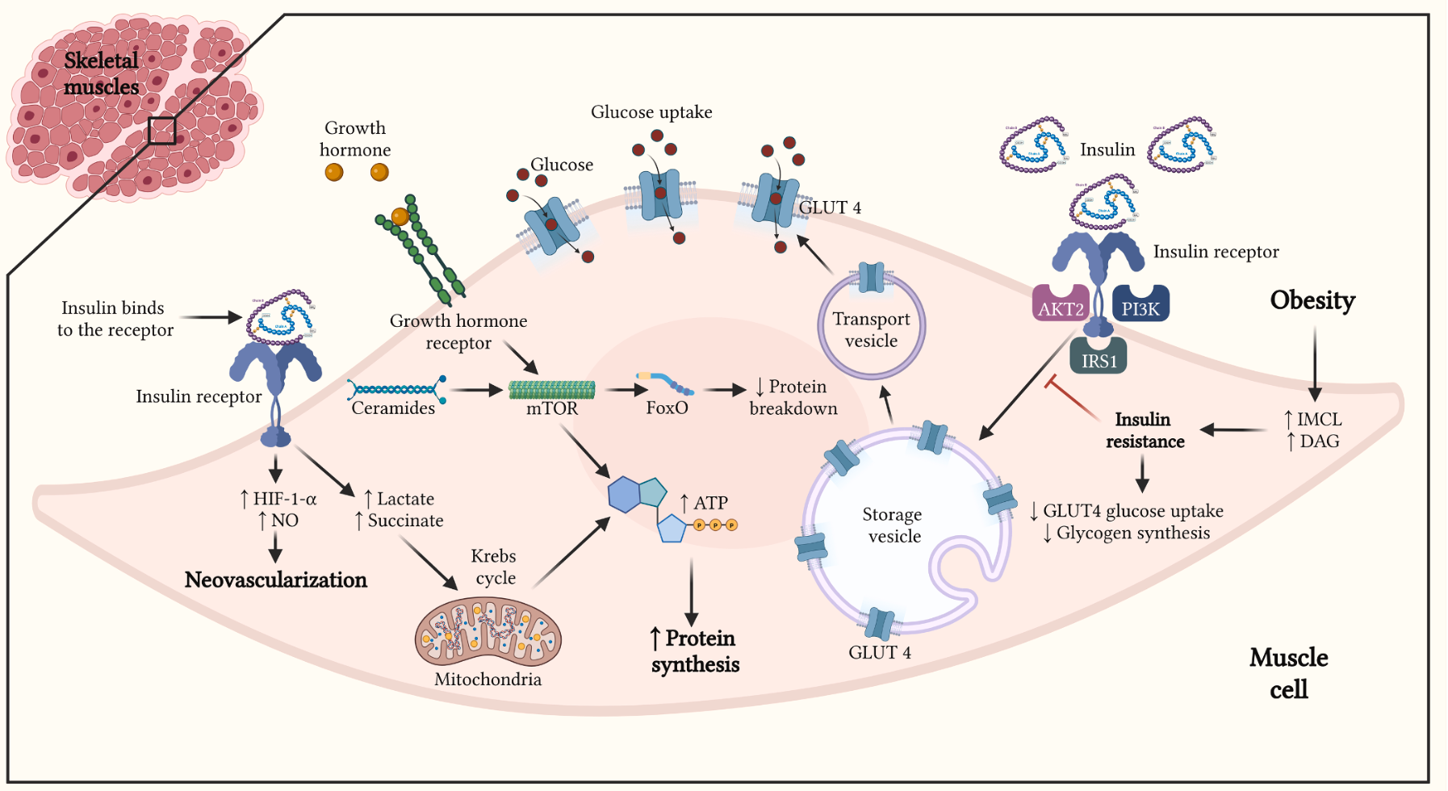
Glucagon-like peptide-1 receptor agonists and muscle mass effects
Ceasovschih A, Pharmacol Research 2025

Slide 24
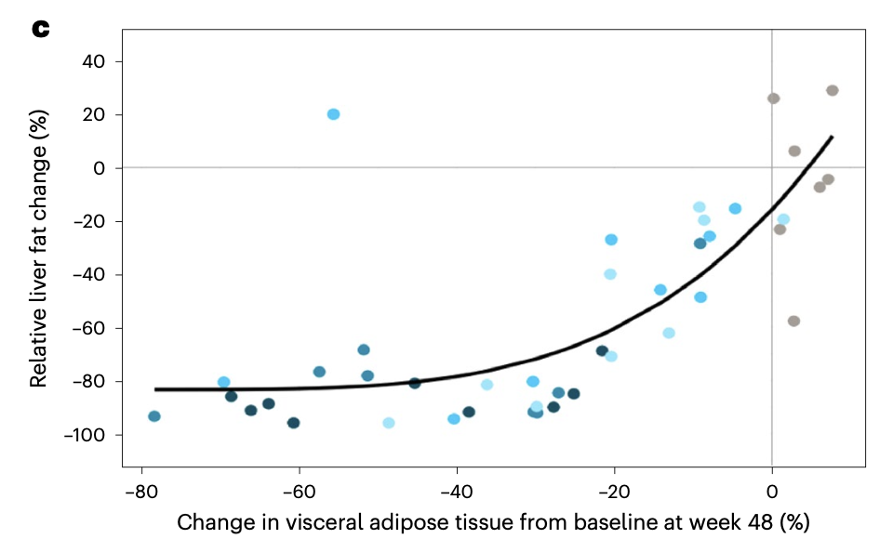
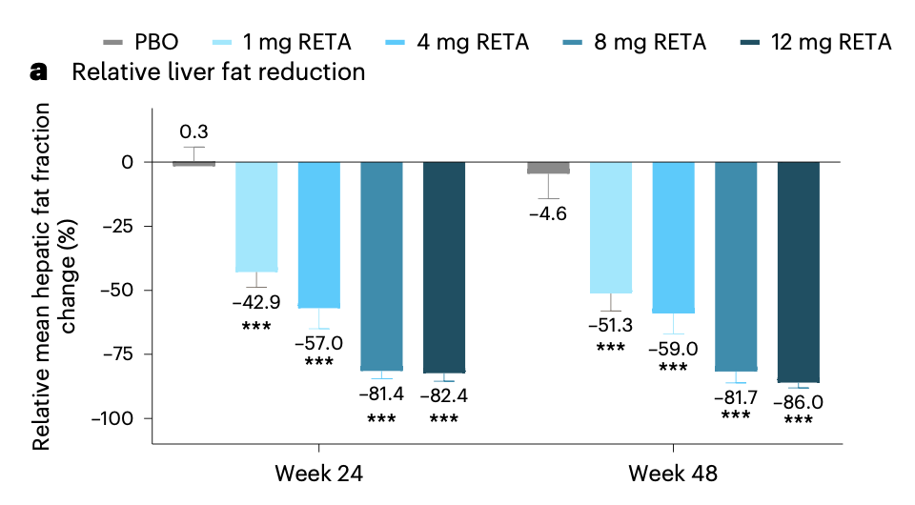
Triple hormone receptor agonist retatrutide
Normal LF (<5%) was achieved by 27% (1 mg), 52% (4 mg), 79% (8 mg), 86% (12 mg) and 0% (placebo) of participants.
LF reductions were significantly related to changes in body weight, abdominal fat and metabolic measures associated with improved insulin sensitivity and lipid metabolism.
Sanyal AJ, Nat Medicine 2023
Notes:
Liver fat content was assessed with MRI–PDFF (Proton Density Fat Fraction)
and was expressed as the mean fat fraction across all nine user-defined
regions of interest in the liver. The average value of the nine regions
of interest was analyzed as the mean hepatic fat fraction. The regions
of interest were defined on the shortest time to echo image of each
slice. VAT and ASAT were assessed with body composition analyses by
AMRA Profiler Research (AMRA Medical AB).

Slide 25
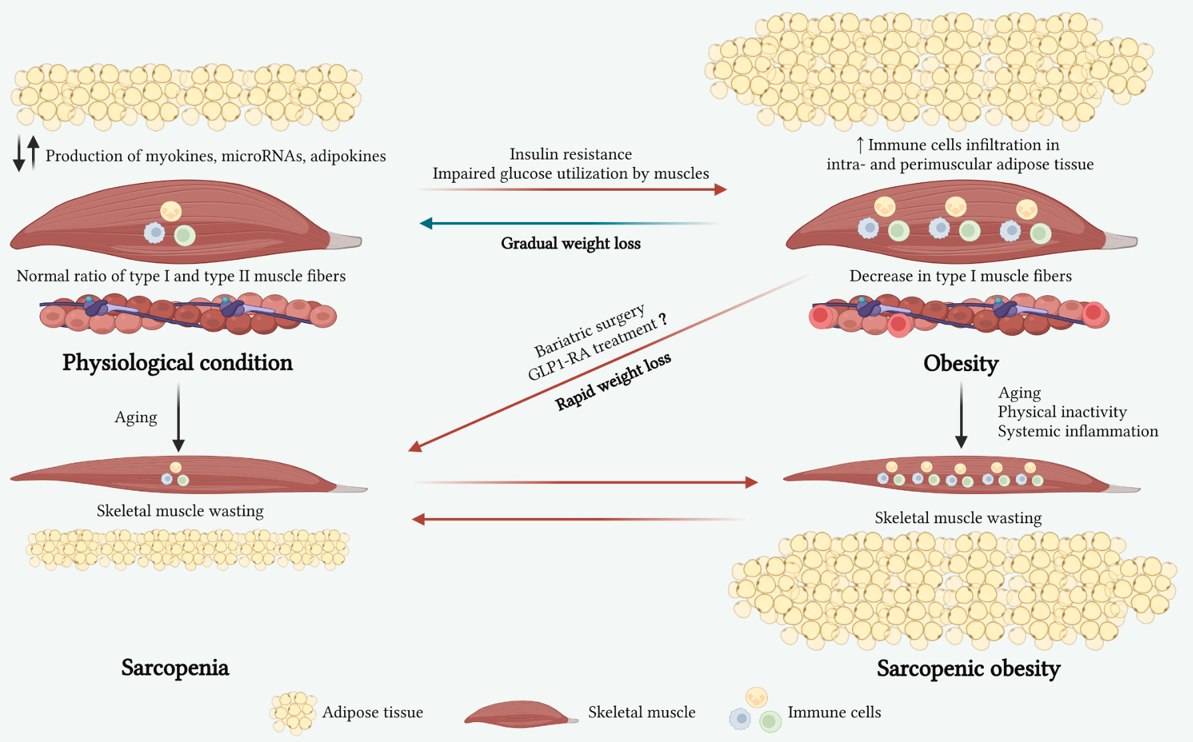
Glucagon-like peptide-1 receptor agonists and muscle mass effects
Skeletal muscle as a key energy consumer
and immunomodulatory hub
Microcirculation
Glucose metabolism
Lipid oxidation
Mitochondrial activity
insulin resistance
metabolic dysfunction
Sarcopenic obesity
-high risk of falls
-decreased quality of life
-increased risk of CV disease
-increased mortality
Ceasovschih A, Pharmacol Research 2025
Notes:
Skeletal muscles are one of the key metabolic regulators of the body. In obesity there is
insulin resistance of skeletal muscles, the structure of muscle fibers is disturbed, there is an accumulation of fat and immune cells that promotes inflammation. In case
of rapid weight loss on the background of obesity, the danger is a decrease in muscle mass, along with fat mass, which contributes to the development of sarcopenia.
skeletal muscle is a key energy consumer
and
an organ with immunomodulatory
properties
Aging, obesity and exercise differentially
affect biogenesis and release of secreted exosome-like vesicles and
microRNAs, playing a key role in the progression of muscle mass los
obesity impairs skeletal muscle
microcirculation, glucose metabolism, lipid oxidation, and mitochondrial
activity, which may exacerbate insulin resistance and metabolic
dysfunction
Sarcopenic obesity, which combines sarcopenia and obesity, is a
current problem because it is associated with a high risk of falls,
decreased quality of life, and increased risk of CV disease and mortality

Slide 26
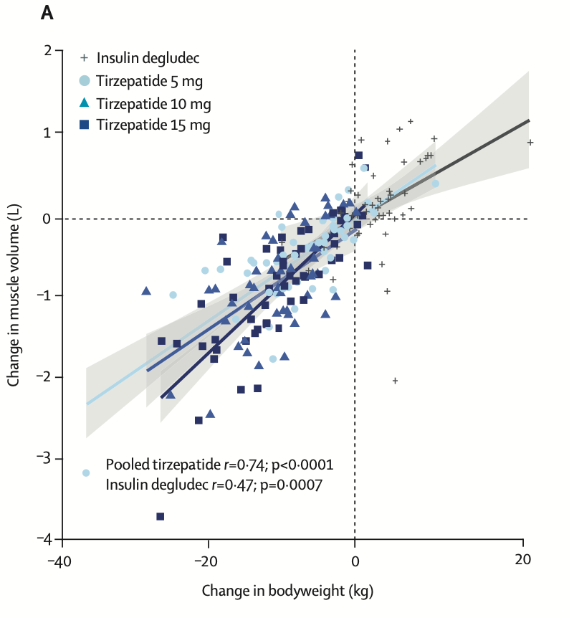
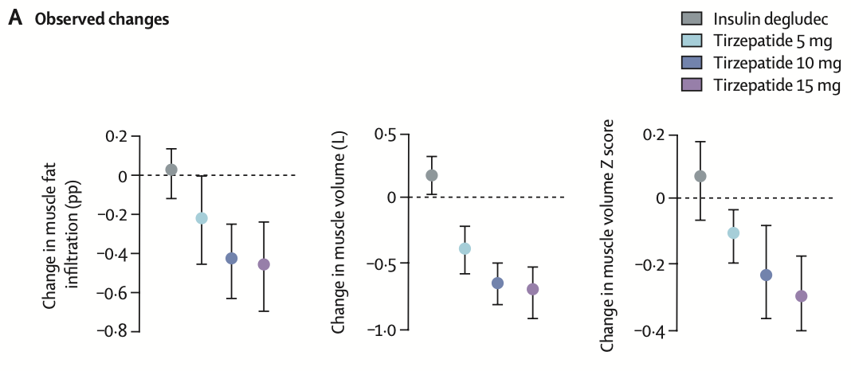
SURPASS-3 MRI post hoc
Tirzepatide and muscle composition in people with type 2 diabetes
Sattar N, Lancet Diab End 2025
Notes:
In people with type 2 diabetes and overweight or obesity, in the context of significant improvements in bodyweight and fat distribution, treatment with tirzepatide was associated with favourable changes in muscle fat infiltration and reductions in muscle volume that appeared to be broadly adaptive to the degree of weight reduction. These data support the clinical benefits observed in clinical trials with tirzepatide and provide additional evidence regarding the potential metabolic effects of this dual GIP and GLP-1 receptor agonist.
There are some important aspects to consider when interpreting the results of this analysis. There is a paucity of research on the change in muscle mass and myosteatosis with pharmacological interventions, particularly those that induce large weight reductions, and often an absence of standardisation on the type of techniques and measurements used for the assessment. For example, body composition was evaluated with dual-energy x-ray absorptiometry in a subgroup of participants
in the SURMOUNT-1 and STEP-1 studies, and both studies showed a reduction in total fat mass with a relatively lower reduction in lean mass with tirzepatide (SURMOUNT-1) and semaglutide (STEP-1).25,26 However, these studies did not report the proportion of muscle mass loss out of total lean mass loss, or change in myosteatosis.
As the study was not specifically designed to evaluate muscle-related changes, assessments of strength, mobility, and physical performance are not available.
Although changes in these parameters might occur without changes in muscle composition, MRI-based muscle volume and muscle fat infiltration assessments
have shown strong correlations with these outcomes. For example, in study populations representative of a general population, both MRI-based muscle volume and muscle
fat infiltration have been shown to significantly and independently associate with muscle strength, mobility, and physical performance.
The use of muscle volume Z score (instead of muscle volume) has a stronger association to muscle strength, mobility, and physical performance.

Slide 27
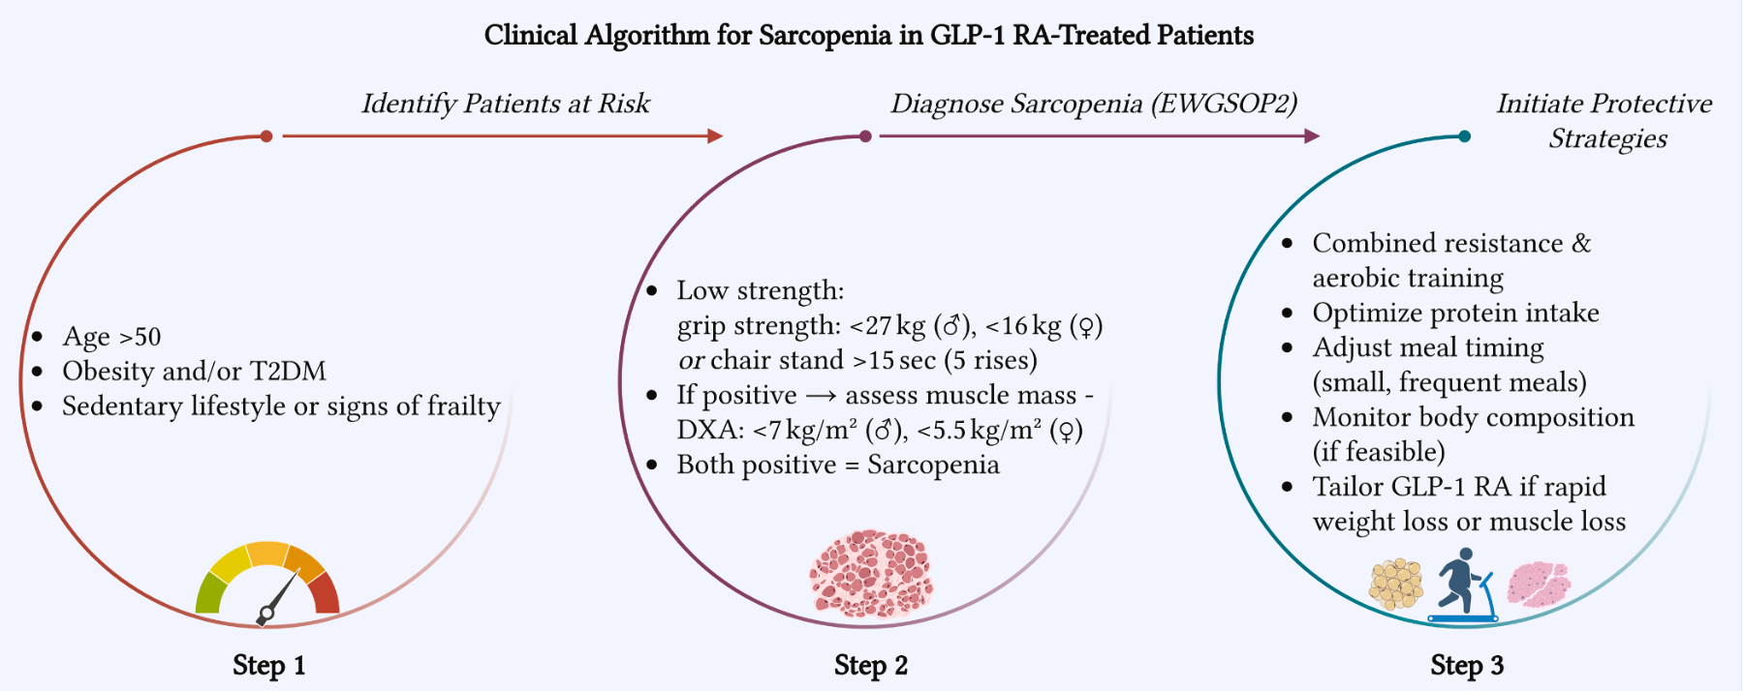
Glucagon-like peptide-1 receptor agonists and muscle mass effects
Ceasovschih A, Pharmacol Research 2025

Slide 28
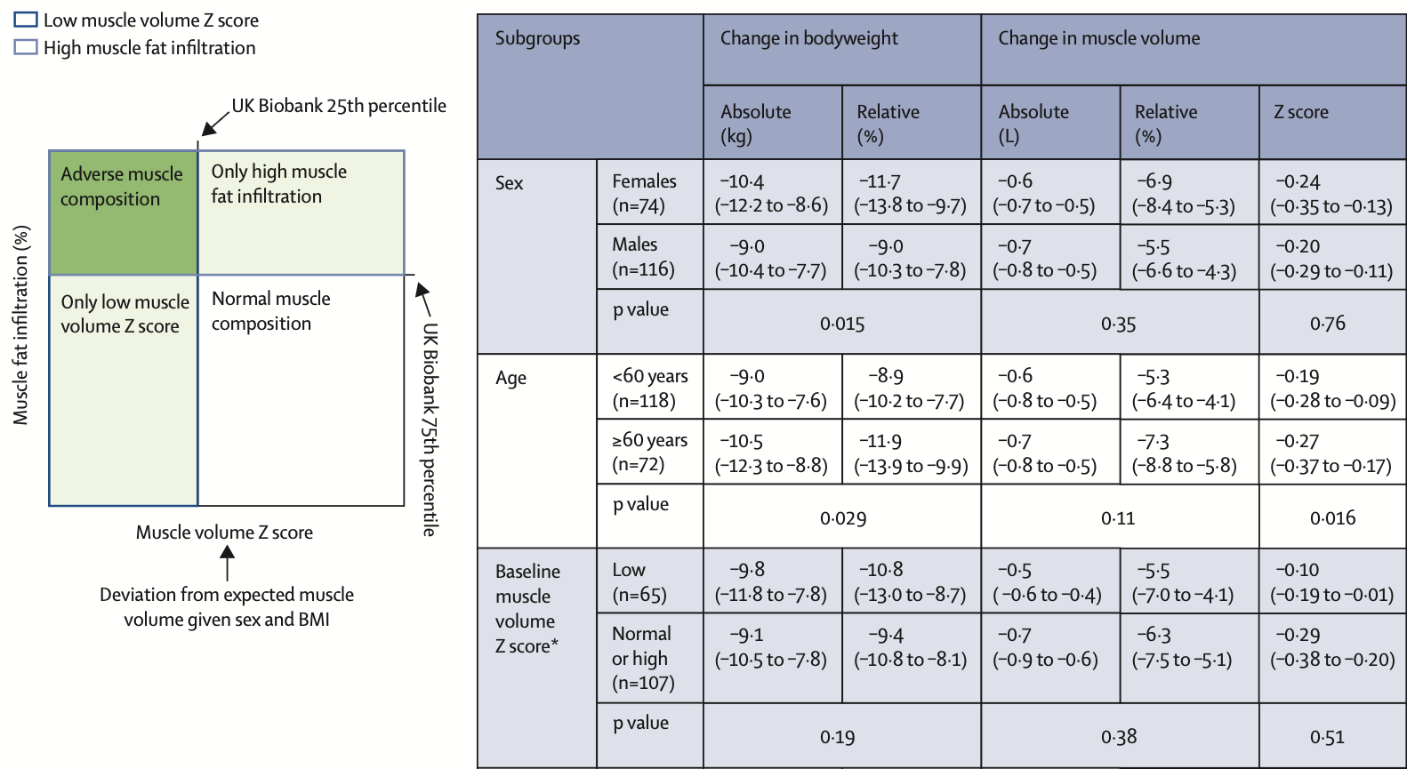
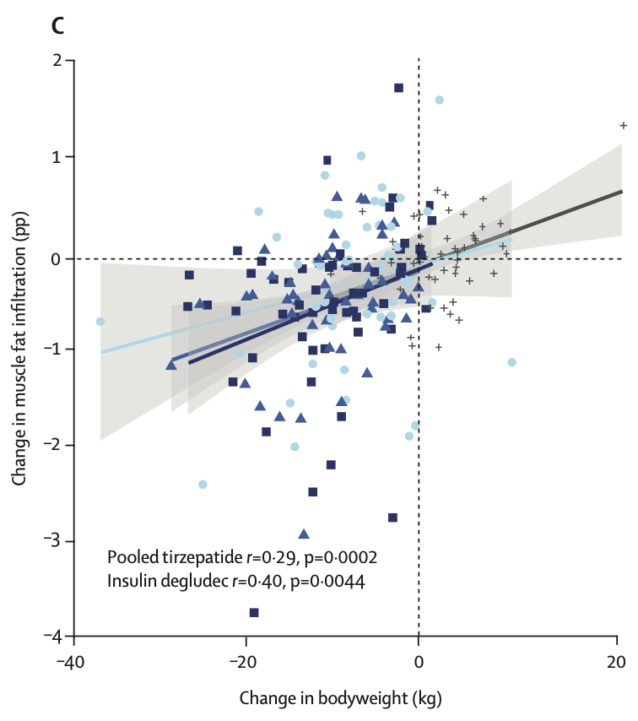
SURPASS-3 MRI post hoc
Tirzepatide and muscle composition in people with type 2 diabetes
Sattar N, Lancet Diab End 2025
Notes:
In the SURPASS-3 MRI substudy, in the context of significant improvements in bodyweight and fat
distribution, tirzepatide treatment was associated with potentially favourable changes in muscle fat infiltration and
reductions in muscle volume broadly in accordance with the general association between changes in muscle volume
and bodyweight. The present findings provide additional information on the potential effect of tirzepatide on muscle
health that might help health-care providers when deciding among treatment options for individual patients.

Slide 29
Combination therapy for maintaining muscle mass
EASD 2025 - COURAGE study (J Rosenstock et al) - ongoing
605 adults with obesity (BMI at least 30) randomized to
semaglutide 2.4 mg subcutaneously and 2 placebos
semaglutide + trevogrumab (200 mg) and a placebo
semaglutide + trevogrumab (400 mg) and a placebo
semaglutide + trevogrumab (400 mg) + garetosmab.
Semaglutide alone led to 10.1% weight loss, of which an average of 6.7 kg was fat mass and 3.3 kg was muscle mass. Addition of trevogrumab 400 mg reduced the loss of muscle mass (–1.5 to –2.4 kg) and resulted in a greater proportion of fat loss (up to 8.5 kg).
Triple therapy with garetosmab: average weight loss of –13.4%, of which 11.8 kg was fat and only 0.9 kg was muscle mass.
More side effects: in the triple therapy group, there were 21 serious adverse events, including muscle cramps, more frequent discontinuation of treatment, and 2 deaths (1 of which was due to COVID-19).
Notes:
Primary endpoints: change in fat mass, fat-free mass, and total body weight at week 26, measured by DEXA scan
The researchers hypothesized that dual agonists (GIP and GLP-1) offer advantages over single GLP-1 agonists. The study therefore examined two new drugs: the myostatin inhibitor trevogumab and the activin A inhibitor garestosmab. Mosenzon: "By influencing both peripheral metabolic pathways and central regulation of appetite and glucose metabolism, not only are weight and glucose regulation improved, but B-cell function may also be preserved and cardiorenal protection increased."

Slide 30
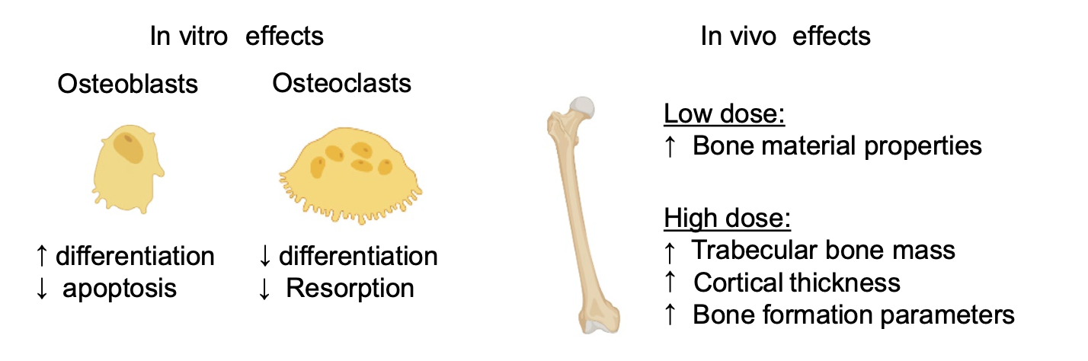
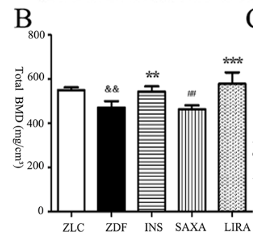
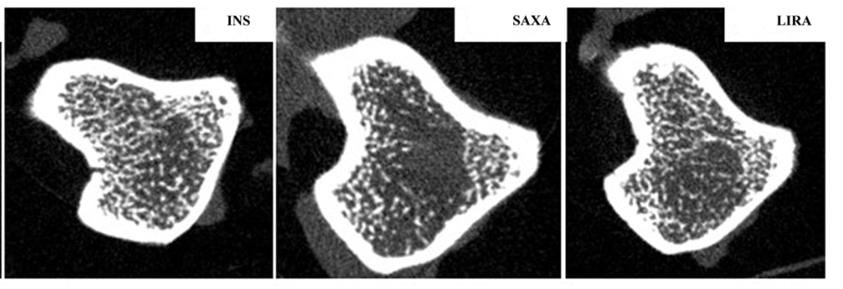
Glucagon‑Like Peptide‑1 Receptor Agonists on Bone Health
GLP-1 receptor agonist promotes osteoblastogenesis
and suppresses bone resorption
Liraglutide improves bone trabecular microarchitecture of ZDF rats
Cheng J, BMC Musculoskeletal Disorders 2022
Herrou J, Calcif Tissue Int 2024
Notes:
RAGE pathway
Liraglutide improved bone trabecular microarchitecture of ZDF rats
As displayed by the micro-CT scans, ZDF rats exhibited
fewer, thinner and more broken trabecular bones, as well
as lower BMD in femur compared with the rats in the nor-
mal control group (Fig. 3A-J). The trabecular architecture
was remarkably improved in the liraglutide- and insulin-
treated ZDF rats compared with the control ZDF rats.

Slide 31

Glucagon‑Like Peptide‑1 Receptor Agonists on Bone Health

Slide 32
Glucagon‑Like Peptide‑1 Receptor Agonists on Bone Health
Most of positive effects on bone were observed at concentration much higher than those approved for weight reduction in PwO
Studies are needed to assess whether prolonged incretin-based therapies for obesity such as GLP-1Ra can off-set bone loss associated with accelerated bone remodeling usually observed during weight-loss
Herrou J, Calcif Tissue Int 2024
Notes:
Abstract
Glucagon-like peptide-1 Receptor agonists (GLP-1Ras) such as liraglutide and semaglutide have been recently approved as
medications for chronic weight management in people living with obesity (PwO); GLP-1 may enhance bone metabolism and
improve bone quality. However, the effects of GLP-1Ras on skeletal health remain to be determined and that's the purpose
of this narrative review. Nevertheless, bone consequences of intentional weight loss interventions in PwO are well known:
(i) significant weight loss induced by caloric restriction and bariatric surgery results in accelerated bone turnover and bone
loss, and (ii) unlike caloric restriction interventions, PwO experience a substantial deterioration in bone microarchitecture
and strength associated with an increased risk of fracture after bariatric surgery especially malabsorptive procedures. Lira-
glutide seems to have a positive effect on bone material properties despite significant weight loss in several rodent models.
However, most of positive effects on bone mineral density and microarchitecture were observed at concentration much
higher than approved for obesity care in humans. No data have been reported in preclinical models with semaglutide. The
current evidence of the effects of GLP-1Ra on bone health in PwO is limited. Indeed, studies on the use of GLP-1Ra mostly
included patients with diabetes who were administered a dose used in this condition, did not have adequate bone parameters
as primary endpoints, and had short follow-up periods. Further studies are needed to investigate the bone impact of GLP-1Ra,
dual- and triple-receptor agonists for GLP-1, glucose-dependent insulin releasing polypeptide (GIP), and glucagon in PwO.

Slide 33


GLP-1RA as brain drugs
L
D
Liraglutide vs dapagliflozin on olfactory Neural Activation and Cognitive Capacity
Kokkorakis M, Pharmacological Rev 2025
Chen H, Diab Care 2022
Notes:
(1) orbitofrontal cortex; (2) parietal cortex; (3) putamen; (4) hypothalamus; (5) insula; (6) nucleus tractus solitarii; (7) area postrema;

Slide 34


Cerebrovascular accumulation of lipidated
Ex4 peptides is unrelated to GLP-1R expression
Exendin‑4 improves long‑term potentiation and neuronal dendritic growth
fatty acid acylation increases brain access of Ex4.
G. Skovbjerg, Neuropharmacology 2023
Wang M, Scient Rep 2021
Notes:
High zoom optical section of
Ex4_C18DA800 labelling in the hypothalamus, 200 μm
thick section in XY direction. Scale bar, 100 μm.

Slide 35
Conclusioni
Rimodellamento corporeo e risposta metabolica Glp1, GIP, Gluc RA riflettono un’espressione recettoriale ubiquitaria
Calo ponderale ed effetto su tessuto adiposo/muscolo scheletrico rappresentano uno degli elementi chiave di un complesso quadro meccanicistico
Molti aspetti restano ancora non indagati
Effetti a lungo termine su sistema CV, rene, SN, apparato muscolo-scheletrico

Slide 36

Joslin Diabetic manual
1929
GRAZIE
PER L’ATTENZIONE

Slide 38


Def: systemic disorder characterized by pathophysiological interactions among metabolic risk factors, CKD, and the cardiovascular system, leading to multiorgan dysfunction and a high rate of adverse cardiovascular outcomes.
Knowledge Gaps
AHA scientific statement, Circulation. 2023

Slide 39

CKM Health Stages
Individuals with overweight/obesity, abdominal obesity, or dysfunctional adipose tissue, without the presence of other metabolic risk factors or CKD
Individuals with metabolic risk factors (hypertriglyceridemia (≥135 mg/dL), hypertension, MetS, diabetes) or CKD
Subclinical ASCVD or subclinical HF among individuals with excess/dysfunctional adiposity, other metabolic risk factors, or CKD
Clinical CVD (coronary heart disease, heart failure, stroke, peripheral artery disease, AFib) among individuals with excess/dysfunctional adiposity, other metabolic risk factors, or CKD
Stage 4a: no kidney failure
Stage 4b: kidney failure present
AHA scientific statement, Circulation. 2023

Slide 40

A step toward multidisciplinary and inclusive care
Evaluating exposure to adverse social determinants of health across the lifespan
Claudel, Cell Metab 2023
Notes:
qually relevant to the dis- cussion of prevention are environmental and economic determinants of health. Environmental determinants include exposure to crime, hazardous pollutants, climate change microenvironments (such as urban heat islands), and other neighborhood-level factors that drive in-
flammatory and oxidative stress pathways leading to poor CKM health.

Slide 41
A step toward multidisciplinary and inclusive care
preventative measures
Reducing overweight or obesity and adoption of disease-modifying therapies
Evaluating exposure to adverse social determinants of health across the lifespan
Claudel, Cell Metab 2023
Notes:
qually relevant to the dis- cussion of prevention are environmental and economic determinants of health. Environmental determinants include exposure to crime, hazardous pollutants, climate change microenvironments (such as urban heat islands), and other neighborhood-level factors that drive in-
flammatory and oxidative stress pathways leading to poor CKM health.

Slide 42

Tirzepatide for Heart Failure with Preserved Ejection Fraction and Obesity
SUMMIT Study
Composite of Death from Cardiovascular Causes or a Worsening Heart-Failure Event
731 pts
BMI >30 kg/m2
HFpEF (EF>50%)
Median follow-up 104 weeks
Weight -13.9% vs -2.2%, P<0.001
Packer, NEJM 2024

